Slide 1
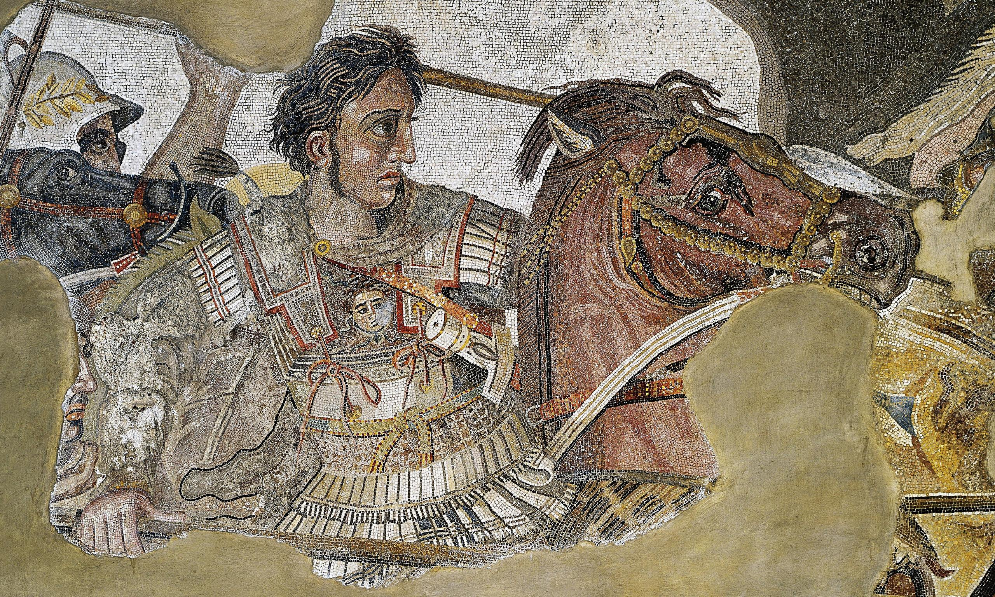
ATG - Review
Goal/s:
Review the Challenges of ATG
Week 2 Lesson 3 – unit 2
Ms Barrie

Slide 2
Overview of ATG – Week 1 and 2
Tuesday | Wednesday | Thursday | Friday
Poster | ATG - Legacy | SUMMARY Early Life | SUMMARY Key Battles
SUMMARY Methods/Aims | SUMMARY Impacts | SUMMARY Challenges | SUMMARY Legacy

Slide 3
ATG’s challenges
Summary topic five

Slide 4
Class Discussion
What do you already know about ATG’s Challenges?
Think about:
Key people
Key Ideas
Key events
FILL IN YOUR MIND MAP

